Slide 1
Sacred Heart Voluntary Academy
Pupil Premium

Slide 2
What is Pupil Premium?
Pupil Premium is funding from the government allocated to schools to help them improve the attainment of their disadvantaged pupils. Funding is based on the number of pupils they have in January who have registered for a free school meal at any point in the last 6 years, children who are in care or adopted, and children whose parents are currently serving in the armed forces.

Slide 3
A Tiered Approach to Pupil Premium
Quality First Inclusive Teaching
Targeted Academic Support
Wider Strategies
Notes:
Government strategy for schools is to divide funds into 3 sections. Majority of funding should be to improve teaching and learning in the classroom, then to provide support to improve children’s progress and attainment/outcomes, then any other areas that may need to support.

Slide 4
A Tiered Approach to Pupil Premium
1. Teaching
Ensuring good and outstanding teaching is the most important thing schools can do to improve outcomes for pupils. Using the Pupil Premium Grant to improve teaching quality benefits all pupils and has a particularly positive effect on children eligible for Pupil Premium. Our priority is to ensure that a highly effective teacher is in front of every class, and that every teacher is supported to keep improving.
Quality First Inclusive Teaching
Targeted Academic Support
Wider Strategies
Notes:
Government advice is to make this the main area of spending. Excellent teaching will improve pupil outcomes.

Slide 5
A Tiered Approach to Pupil Premium
1. Teaching
Providing continual training, and mentoring, in all areas of the curriculum but particularly English and Maths so that all pupils are able to access high quality learning.
Support curriculum planning to ensure gaps are identified and new material builds on secure foundations.
Quality First Inclusive Teaching
Targeted Academic Support
Wider Strategies
Notes:
What we do at PJS…

Slide 6
1-1 with the class teacher
The class teacher will spend time 1:1 with your child once a week at least prioritising marking their English and Maths books alongside them. This is a process called live marking. It is a time for each child to reflect on their learning and progress – how they learn best and how they can use these strategies to help them learn better in other areas.
Notes:
Conferences allow for pupil voice.

Slide 7
A Tiered Approach to Pupil Premium
2. Targeted Academic Support
Evidence consistently shows the positive impact that targeted academic support can have, including on those who are not making good progress across the spectrum of achievement. We consider how classroom teachers and teaching assistants can provide targeted academic support, including how to link structured one-to-one or small group intervention to classroom teaching.
Quality First Inclusive Teaching
Targeted Academic Support
Wider Strategies
Notes:
Provides support to improve academic progress and outcomes.

Slide 8
A Tiered Approach to Pupil Premium
2. Targeted Academic Support
Quality First Inclusive Teaching
Providing high-quality group tuition during school by the class teacher to ‘bridge the gap’.
Teaching Assistants providing one to one and small group targeted support
Specific catch up planning for pupils.
Targeted Academic Support
Wider Strategies
Notes:
Teachers provide focus teaching in small groups after identifying gaps in learning. Work in collaboration with TA to provide support.

Slide 9
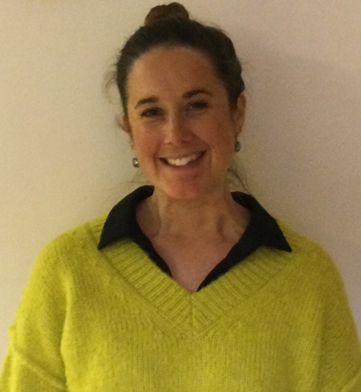
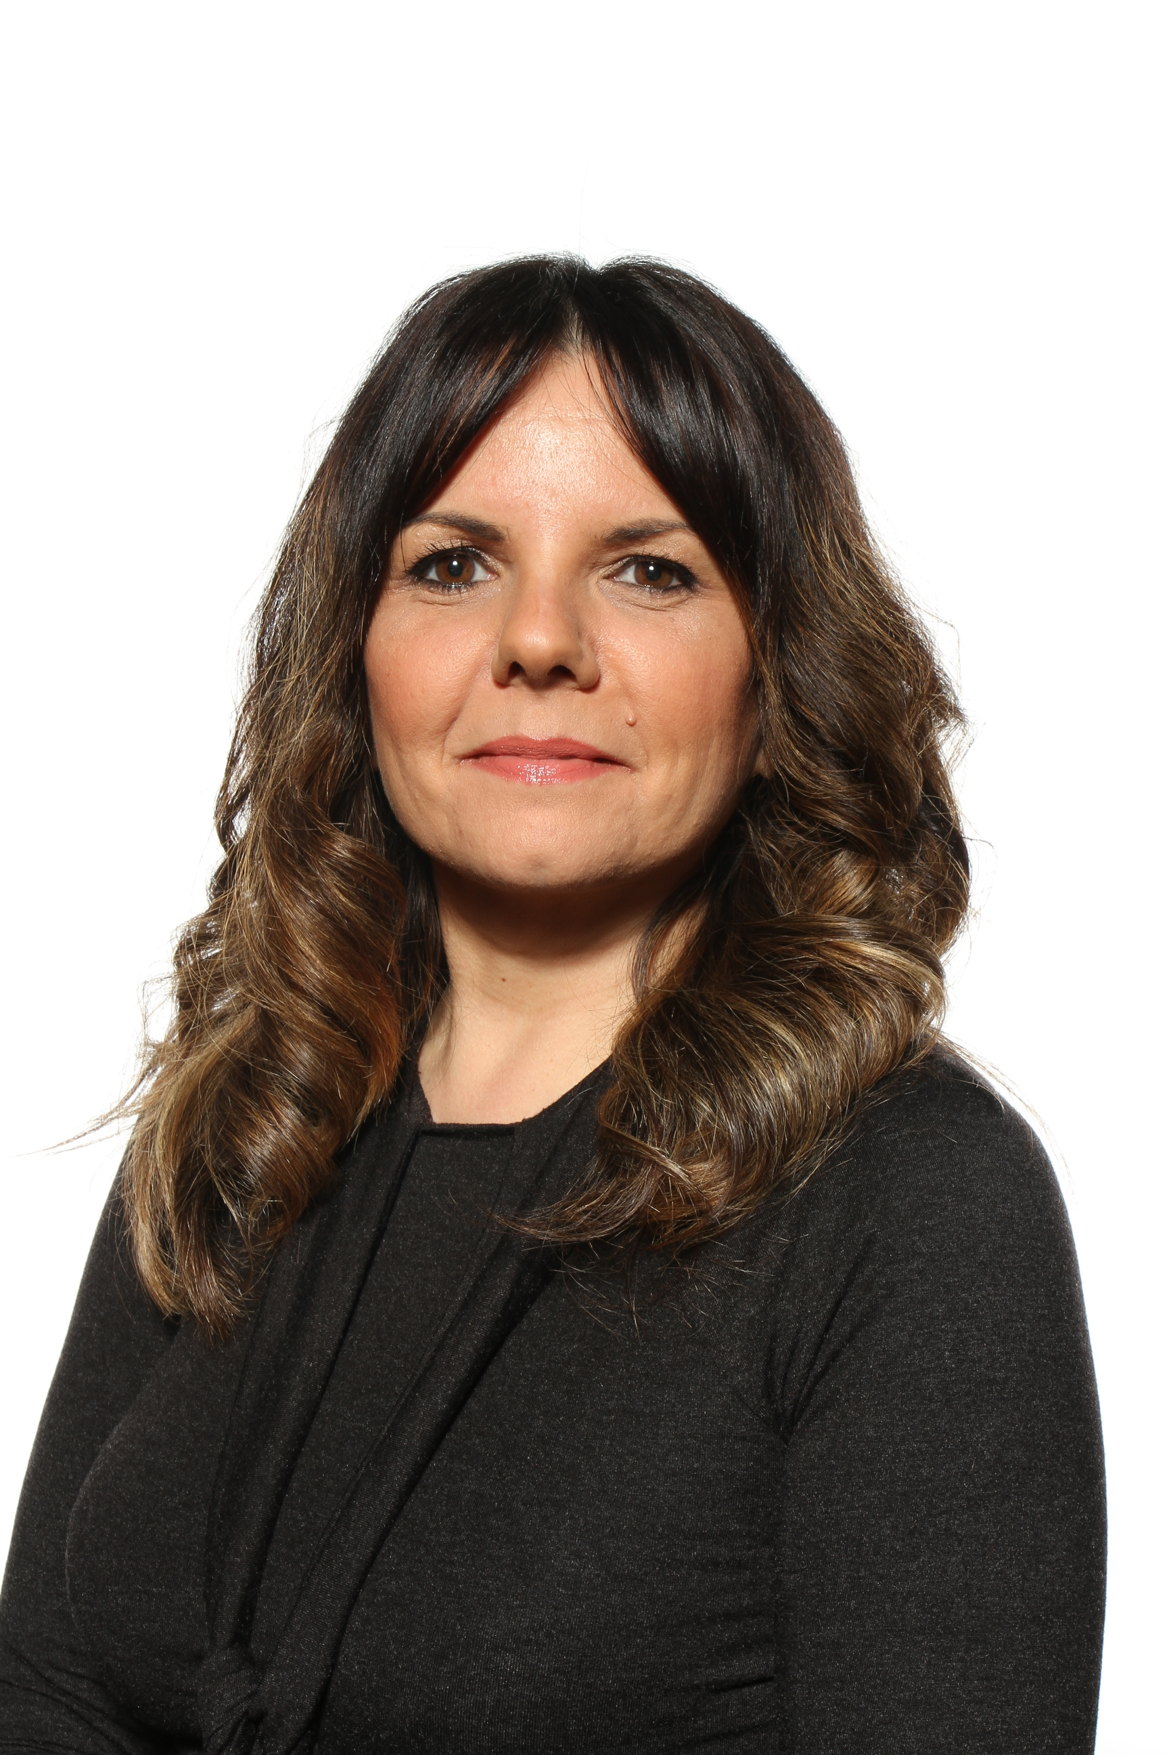
What it looks like at Sacred Heart…
Pupil Premium Champions
Alongside the class teacher and teaching assistant, the pupil premium champion works closely with the children to help them achieve success with their targets. They liaise closely with the class teacher, SEND advisor, and the schools ELSA (Emotional literacy Support Assistant) to plan interventions/support that will compliment the learning they are doing in class and close any gaps.
Mrs Keast – Teacher and Pupil Premium Specialist
Mrs Genco-Billington – ELSA Support and HLTA
Notes:
Government have provided additional funding for children to catch-up. We have 4 ‘pupil Premium champions. – 1 for each year group. Provide support in extra tuition/interventions in and out of school.

Slide 10
A Tiered Approach to Pupil Premium
3. Wider Strategies
Quality First Inclusive Teaching
We aim to focus on the most significant needs, including attendance, behaviour and social/emotional support.
Targeted Academic Support
Wider Strategies
Notes:
Social/emotional support is the biggest area of extra need currently.

Slide 11
A Tiered Approach to Pupil Premium
3. Wider Strategies
ELSA small group and one to one nurture time to support children emotionally and socially.
ELSA champion regularly supports teachers throughout the school to ensure they are supporting the children's well being fully.
Lunch Time play leaders
Support for parents such as help with applying for grants or additional time to support with homework, advice etc.
Quality First Inclusive Teaching
Targeted Academic Support
Wider Strategies
Notes:
Thrive approach is based on attachment and behaviour psychology.
Restorative approach to behaviour – recognising and improving behaviour not just punishing.

Slide 12
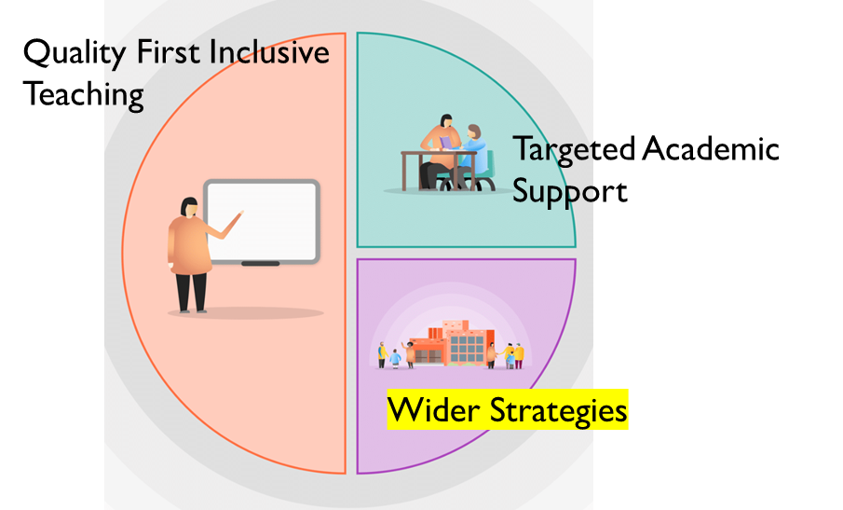
Other support offered
We believe that all children should have the very best opportunities outside of their academic opportunities. All PPG children at Sacred Heart have free high quality music teaching from Leicestershire Arts, swimming lessons and all school trips paid for.
In addition, all after school clubs are free and we ask those children/parents who are not attending any clubs what further opportunities we could offer that they might be interested to participate in.
PPG can access free uniform from our Preloved clothes and £50 towards a pair of school shoes each year.

Slide 13
MYTH: “The Pupil Premium has to be spent on interventions”
There is a strong evidence base showing the impact that high quality interventions can have on the outcomes of struggling students. However, while interventions may well be one part of an effective Pupil Premium strategy, they are likely to be most effective when deployed alongside efforts to improve teaching, and attend to wider barriers to learning, such as attendance and behaviour.
MYTH: “Only eligible children can benefit from Pupil Premium spending”
The Pupil Premium is designed to support schools to raise the attainment of disadvantaged children. However, many of the most effective ways to do this – including improving the quality of teaching – will also benefit other groups: that is fine. Likewise, some forms of targeted academic support or wider strategies will benefit other children, including children with Special Educational Needs and Children in Need.

Slide 14
Providing targeted academic support for pupils who are not making the expected progress.
Ensuring 'outstanding' teaching in every class.
Our Priorities
Ensuring that all children deserve the very best education, and access to high class extra-curricular activities, no matter what their background; allowing them to reach their full potential and flourish, both academically, and as a whole person.
Addressing non-academic barriers to attainment such as attendance and social and emotional needs.
Live * Learn * Love
Closing the attainment gap between pupils and their peers.
Ensuring that the PPG reaches the pupils who need it most.

