Slide 1
Sacred Heart Coffee Morning
Maths at home

Slide 2
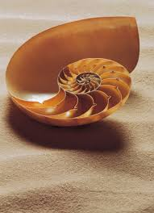
Maths at school
‘A Sacred Heart Maths Student knows why’.
Building blocks.
We use a spiral curriculum.
Reasoning is a key part of learning.
Making links to secure understanding.

Slide 3
Did you enjoy Maths?
Important to not give your child an excuse.
Ask them to teach you what they have been learning.
Ask them why they’re learning it.

Slide 4
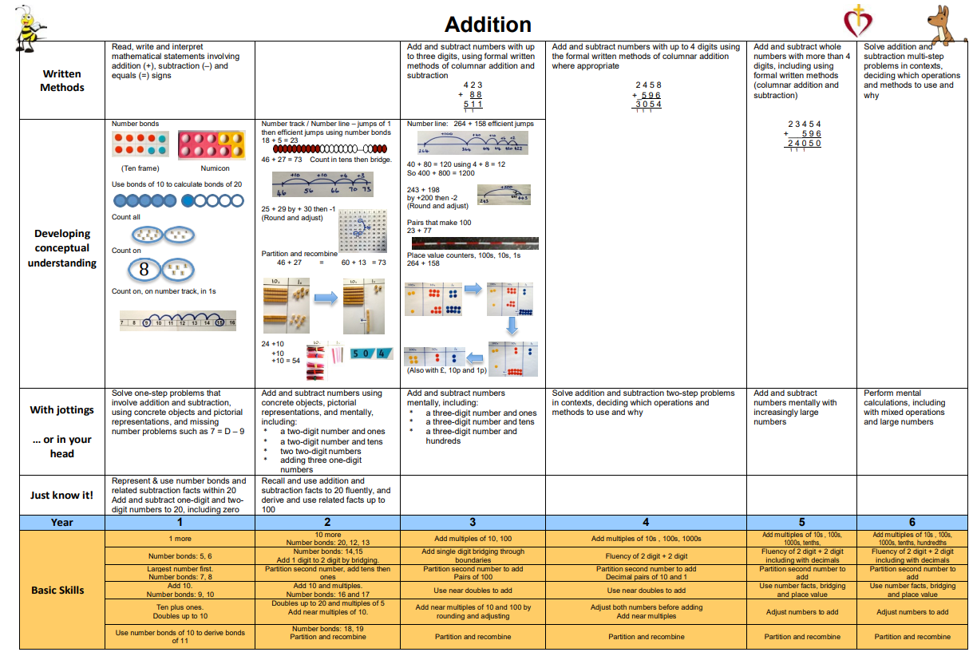
The basics
Place Value
Addition
Subtraction
Multiplication
Division
See Calculation policy

Slide 5
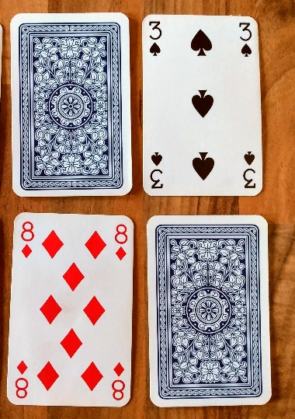
At home
For KS1, biggest help is securing Place Value and understanding relationships between numbers for quick recall (number bonds).
In KS2, securing instant recall of times table and related facts (up to x 12).

Slide 6
Maths at home
Pupil Voice told me that children didn’t recognise that they use Maths outside of school.
Speak to the children about when they use Maths and quiz them.

Slide 7
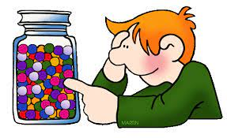
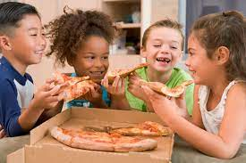
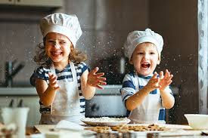
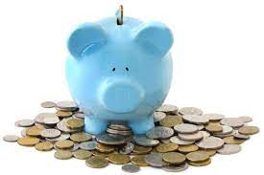
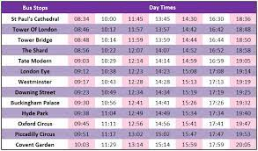
Maths at home

Slide 8
Questions to ask
How much do you estimate ….?
What does that weigh? How much more do I need?
Can you use ratios to change the recipe for more people?
Can you convert that measurement from g to kg?
How can we share this fairly? How much will I have?
Can we afford this? What change will I get?
What is the sale price? How much will I save?
What shapes can you see?
What time will it finish? Where will the hands of the clock be pointing?

Slide 9
And don’t forget…
Have a go with your child at the Monthly Maths Challenge.
They are designed for you to do with your child to encourage maths talk.
Sssshh… and if you want some support, message me on Dojo!
Any questions…?

