Slide 1
Praise Assembly Monday 13 December 2021
Best of Beethoven
Wagner
Top 25 Classical pieces
Live, Learn, Love

Slide 3
ADVENT- Week 3

Slide 4
Synod- answers from every church to Pope Francis

Slide 6
Catholic Virtues- habits of behaviour. New banners!
Rec Kindness
Y1 Friendship
Y2 Forgiveness
Y3 Confidence
Y4 Patience
Y5 Compassion
Y6 Love of Learning

Slide 7
New Parliament lunchtime stickers

Slide 8
Charm School & Fantastic Walking

Slide 9
East Midlands Regional News

Slide 10
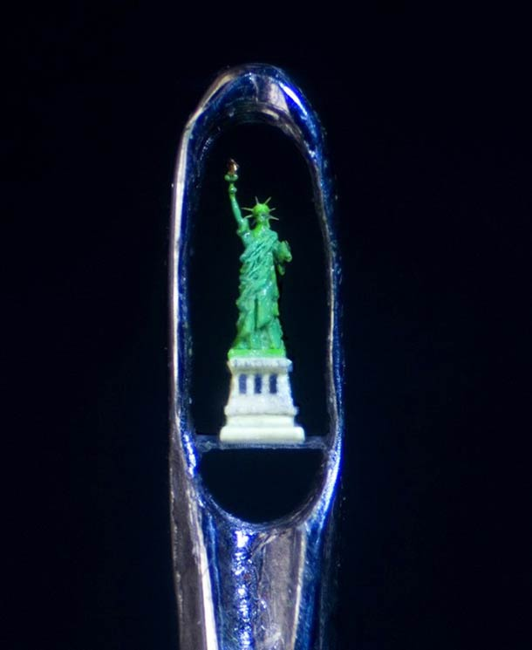
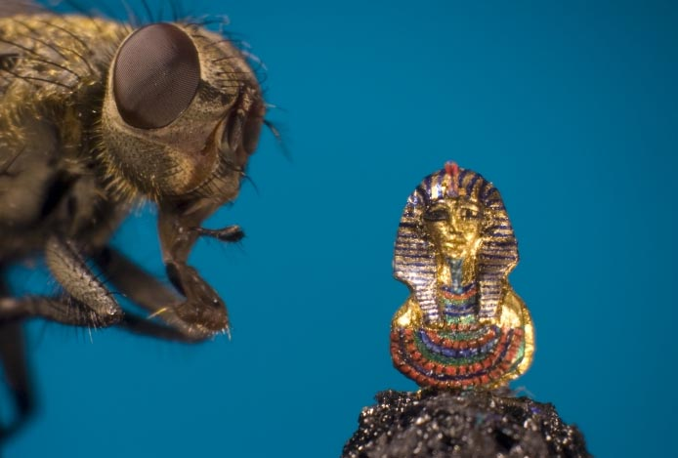
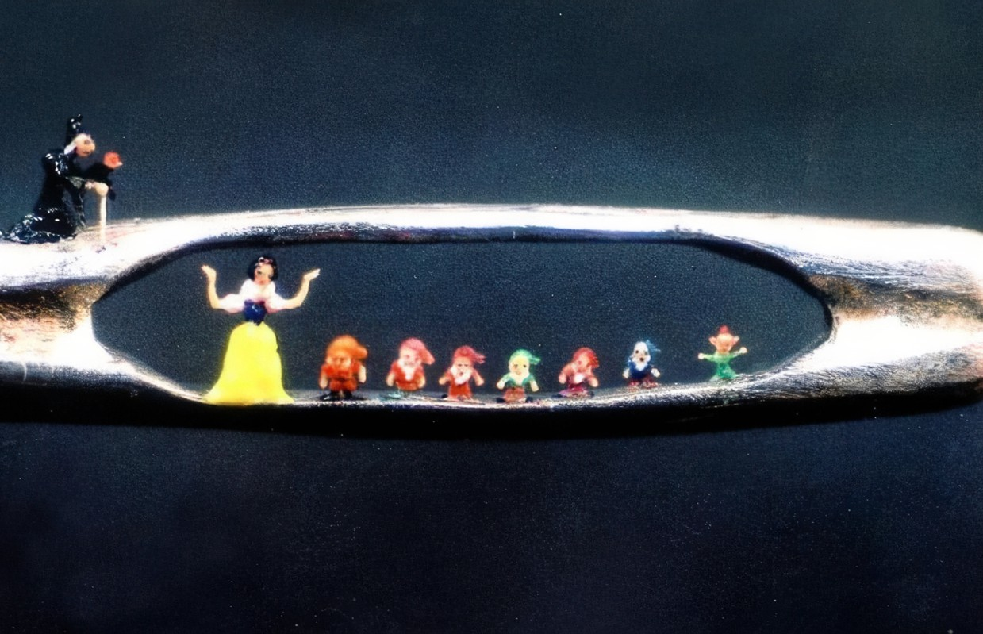
Birmingham artist William Willard MBE

Slide 11
Storm Barra batters UK

Slide 12
Omicron variant

Slide 14
Diplomatic boycott-Countries pull out due to human rights concerns

Slide 15
Tornado kills dozens in Kentucky

Slide 16
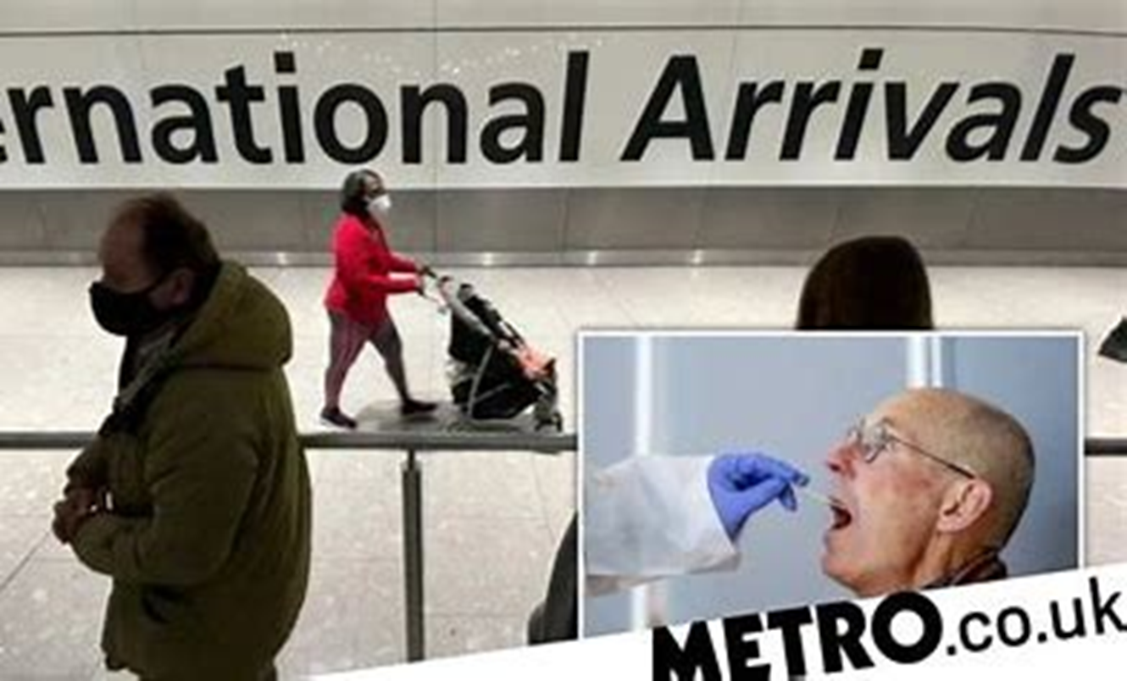
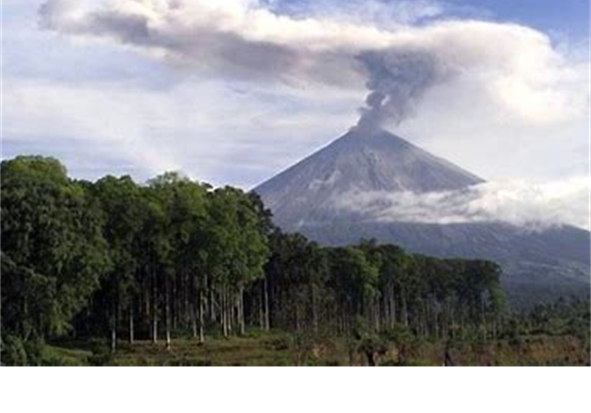
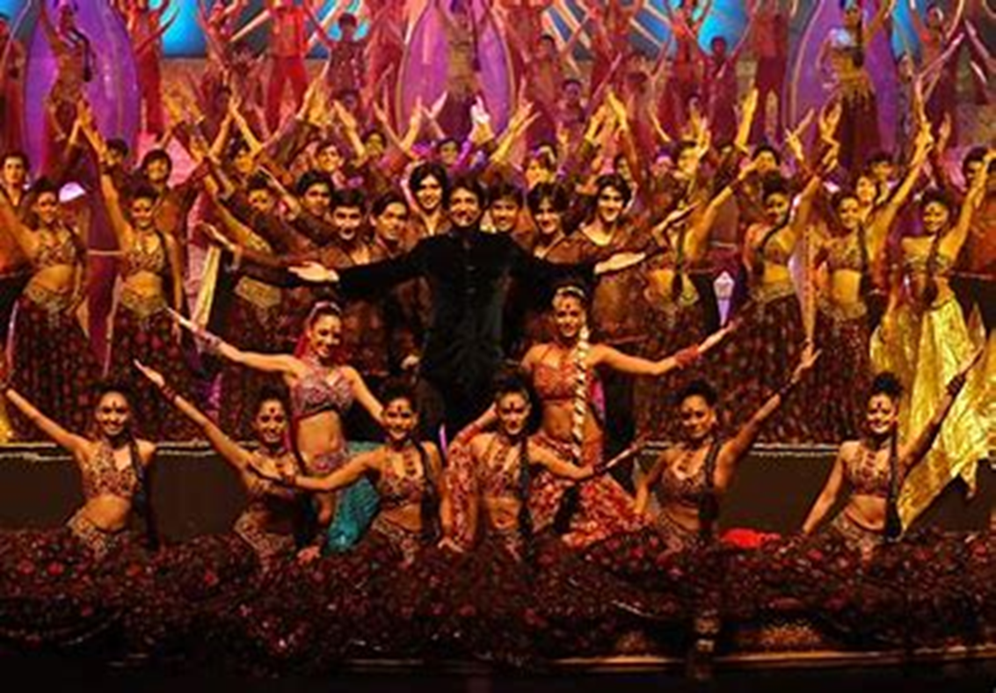
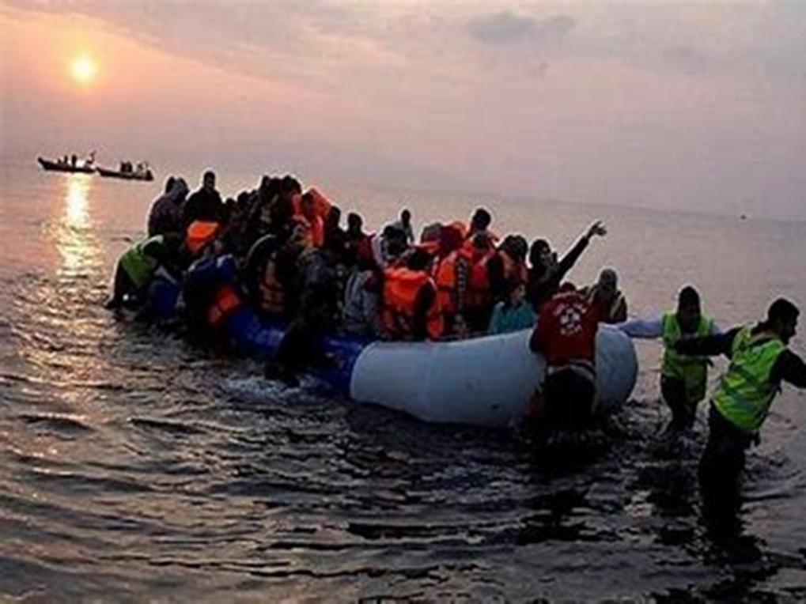

Slide 17
The number of people who have received a booster or third dose vaccination for COVID-19 in the UK Over 20 million people have received a third vaccination.

Slide 21
Line-Peter Doig 1959-British painter. White Canoe $11.3 million

Slide 34
Perseverance
Enthusiasm
Independence
Empathy
Cooperation
Confidence

Slide 35
KS2 Character Muscles
Resilience
Self-Efficacy
Courage
Respect
Curiosity
Concentration

Slide 36
Award Certificates
Curriculum Learning award from your class teacher
Mission Award from your class teacher
Maths Award from Mrs Dowsett
What have you done that you are proud of ?
How have you lived, learned and loved in the Sacred Heart way?

Slide 37
Storytime: Read with a writer’s eye..

Slide 38
Praise Assembly Monday 13 December2021
Bach
Best of Beethoven
Live, Learn, Love

