Slide 1
Praise Assembly Monday 1 February 2021
Best of Beethoven
Top 25 Classical pieces
Live, Learn, Love

Slide 2
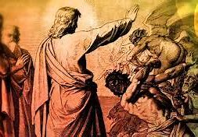
Fourth Sunday of the Year Jesus heals the possessed man.
‘All were amazed and asked one another, “What is this?”’ Mark 1: 21 – 28

Slide 3
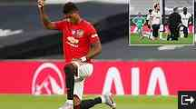
George Floyd Black Lives Matter. Catholic Racial Awareness weekend
Marcus Rashford ‘taking the knee’ has experienced online racist bullying.

Slide 4
NDCYS Challenge- show someone who looks after you that you care.

Slide 6
220 million year old dinosaur print found on beach by 4 year old girl.

Slide 7
Wellbeing Survey

Slide 8
Cardboard shortage

Slide 9
International News

Slide 10
£500 Toilet brush, Russia demonstrations

Slide 11
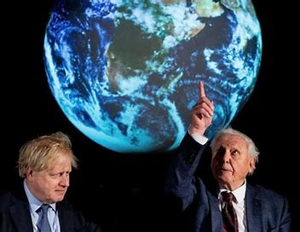
World Summit on Climate Crisis Cop26 in Glasgow, Scotland

Slide 12
Jellyfish slime to the rescue? ‘Gojelly’

Slide 13
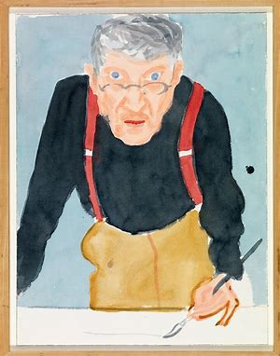
David Hockney 1937- Pop artist
One of the most influential artists of the 20th Century. Painter, photographer, printmaker and stage designer. Popular art, adverts, culture.

Slide 14
Life is beautiful, just look!

Slide 15
David Hockney 1937- Pop artist
Woman with a sewing machine. A portrait of his mother whilst at Art College. He found it ‘liberating’ and spent 1 hours a day in the studio for 4 years.

Slide 16
David Hockney 1937- Pop artist
California Dreaming- A Bigger Splash. Painted a splash took weeks.

Slide 17
David Hockney 1937- Pop artist
Mr & Mrs Clark Percy 1970-1

Slide 18
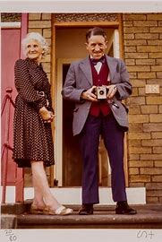
David Hockney 1937- Pop artist
My Parents 1977

Slide 19
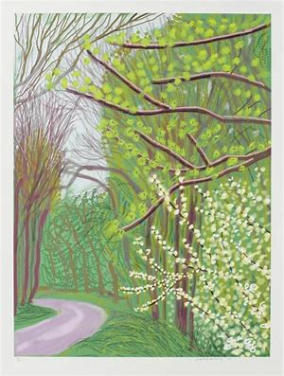
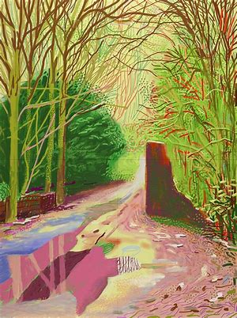
David Hockney 1937- Pop artist
Ipad sketchings- local areas at different times of the day over a month.

Slide 20
Days of Spring, Bradford Exhibition

Slide 21
Photographs.

Slide 24
Pandora’s Box, Thursday at 2.30

Slide 25
Award Certificates
Curriculum Learning award
Mission Award
What have you done that you are proud of ?

Slide 26
Praise Assembly Monday 1 February 2021
Best of Beethoven
Live, Learn, Love

