Slide 1
Praise Assembly Monday 12 October 2020
Mozart film
Mozart Best
Top 25 Classical pieces
Live, Learn, Love

Slide 2
God’s Invitation to live a loving life. 28th Sunday in Ordinary Time

Slide 3
In the News

Slide 4
Prince William and Sir David Attenborough have joined forces to launch what they hope will become the "Nobel Prize for environmentalism". They say the search is on for 50 solutions to the world's gravest environmental problems by 2030. With £50m to be awarded over a decade, the "Earthshot Prize" is the biggest environmental prize ever.

Slide 5
T-Rex skeleton named Stan breaks dinosaur fossil record with £24.5m auction sale The impressive dinosaur skeleton, named after the amateur palaeontologist who discovered it, is 40ft long and 13ft high.

Slide 6
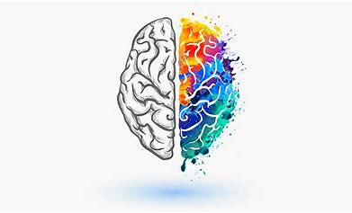
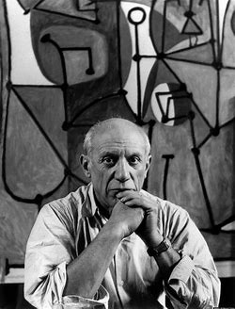
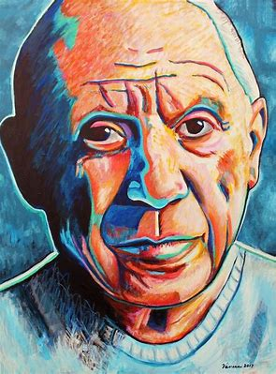
Growth Mindset- Pablo Picasso
It took me four years to paint like Raphael, but a lifetime to paint like a child.
There is no abstract art. You must always start with something. Afterward you can remove all traces of reality.
Three classes of people: Those who see. Those who see when they are shown. Those who do not see.

Slide 7
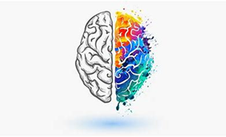
Growth Mindset- Pablo Picasso 1181-1973
The Weeping Woman

Slide 8
Growth Mindset- Pablo Picasso 1181-1973

Slide 9
Growth Mindset- Pablo Picasso 1181-1973

Slide 10
Growth Mindset- Pablo Picasso 1181-1973

Slide 11
Growth Mindset- Pablo Picasso 1181-1973

Slide 12
Growth Mindset- Pablo Picasso 1181-1973

Slide 13
Growth Mindset- Pablo Picasso 1181-1973

Slide 14
Growth Mindset- Pablo Picasso 1181-1973

Slide 15
Growth Mindset- Pablo Picasso 1181-1973

Slide 16
Award Certificates
Curriculum Learning award
Mission Award
What have you done that you are proud of ?
Will you receive the Headteacher Award for always…

Slide 17
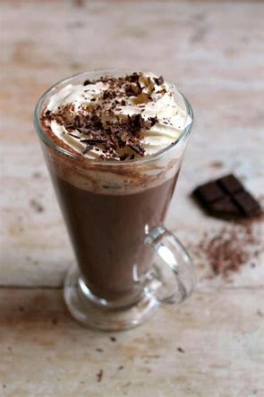
HEADTEACHER AWARDS
Meet me at lunchtime in the Outdoor classroom for hot chocolate, treats and a chat!

Slide 18
Diversity-Baca Charity
https://youtu.be/VzehqwR4OQU
A BIG Sacred Heart welcome to:
Maja in Year 4. I know everyone will make Maje feel very welcome.

Slide 19
Library Launch- Enterprise How much can your class raise? Which class will cut the ribbon and win?

Slide 20
Praise Assembly Monday 12 October 2020
Live, Learn, Love

